Slide 1

Chi-square Automatic Interaction Detector(CHAID) Algorithm.
JAWAHARLAL NEHRU NATIONAL COLLEGE OF ENGINEERING Department of Information Science and Engineering
By,
Sreelakshmi Adiga P.
USN: 4JN16IS100

Slide 2
CONTENTS.
Introduction.
Algorithm.
Statistical terms used.
Advantages.
Disadvantages.

Slide 3
INTRODUCTION TO CHAID.
CHAID (Chi-square Automatic Interaction Detector) analysis is an algorithm used for discovering relationships between a categorical response variable and other categorical predictor variables.
It is useful when looking for patterns in datasets with lots of categorical variables.
It is a convenient way of summarising the data as the relationships can be easily visualized.

Slide 4
CHAID ALGORITHM
Step.1 : Calculate the distribution of the response variable Y in the “root” node
Step.2 : For each explanatory variable X, find that pair of categories of X that are least significantly different (that is has the largest p-value) with respect to the distribution of Y within this node. Step 2. is repeated
Step.3 : The final step is to split the node on the basis of that “merged” explanator with smallest adjusted p-value
Step.4 :Continue to grow the tree until the stopping criteria are satisfied.

Slide 5
PRACTICAL USAGE OF CHAID.
CHAID is often used in direct marketing to understand how different groups of customers might respond to a campaign based on their characteristics.
For example, that we run a marketing campaign and are interested in understanding what customer characteristics (e.g., gender, socio-economic status, geographic location, etc.) are associated with the response rate achieved.
We build a CHAID “tree” showing the effects of different customer characteristics on the likelihood of response.

Slide 6
At the first level (the “trunk”) we have all customers and the overall response rate for the marketing campaign was, say, 24.3%.
As we progress down the tree to the first “branch”, we identify the factor that has the greatest impact on the likelihood of response.
Our overall population is broken down into groups (“leaves”) based upon their differing values of this characteristic – Urban/Rural
We might find that rural customers have a response rate of only 18.6%, whereas urban customers have a response rate of 28.5%.
We check to see if this difference is statistically significant and, if it is, we retain these as new leaves.

Slide 7
At the next branch, for each of the new groups (Urban/Rural), we then consider whether they can be further split into subgroups so that there is a significant difference in the dependent variable.
Urban homeowners may have a much higher response rate (36.1%) compared with urban non-homeowners (22.7%).
Rural full-time workers might have a higher response rate (24.0%) than rural part-time workers (17.8%) or the rural retired/unemployed (5.3%).
At each step every predictor variable is considered to see if splitting the sample based on this factor leads to a statistically significant relationship with the response variable.

Slide 8
If a statistically significant difference is observed then the most significant factor is used to make a split, which becomes the next branch in the tree.
The process repeats to find the predictor variable on each leaf that is most significantly related to the response, branch by branch
It is terminated only when no further factors are found to have a statistically significant effect on the response.
The results can be visualized with a tree diagram.

Slide 9
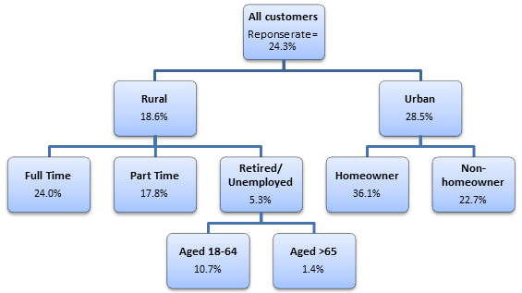
Fig.1. Tree representation of considered example.

Slide 10
In this case, we can see that urban homeowners (36.1%) have the highest response rates, followed by rural full-time workers (24.0%) and that these are therefore the best groups of customers to target.
On the other hand, the lowest response rates were observed for the rural, retired/unemployed, aged over 65 years (1.4%) .

Slide 11
STATISTICAL TECHNIQUES USED.
CHAID uses Person’s Chi-square tests of independence, which test for an association between two categorical variables.
A statistically significant result indicates that the two variables are not independent.
Chi-square tests are applied at each of the stages in building the CHAID tree, to ensure that each branch is associated with a statistically significant predictor of the response variable.
Bonferroni corrections, or similar adjustments, are used to account for the multiple testing that takes place.

Slide 12
ADVANTAGES.
Compared to other algorithms decision trees requires less effort for data preparation during pre-processing.
A decision tree does not require normalization of data.
A decision tree does not require scaling of data as well.
Missing values in the data also does NOT affect the process of building decision tree to any considerable extent.
A Decision trees model is very intuitive and easy to explain to technical teams as well as stakeholders.

Slide 13
DISADVANTAGES.
A small change in the data can cause a large change in the structure of the decision tree causing instability.
For a Decision tree sometimes calculation can go far more complex compared to other algorithms.
Decision tree often involves higher time to train the model.
Decision tree training is relatively expensive as complexity and time taken is more.
Decision Tree algorithm is inadequate for applying regression and predicting continuous values.

Slide 14
THANK YOU.

